Slide 1
GIS Data Management
Theresa Valentine
Andrews LTER

Slide 2
GIS Data Management
Spatial Data/Software
Finding Existing Data to Meet your Research Goals
Special consideration for archiving and publishing spatial datasets
Documenting spatial datasets
Managing Study Site Locations
Demo
Exercise

Slide 3
Spatial Data/Software
Spatial Data Geometry
Associated Attributes
Projections
Software Formats
Exchange Formats
ESRI GIS Software
ArcGIS data types
ArcGIS Desktop Modules

Slide 4
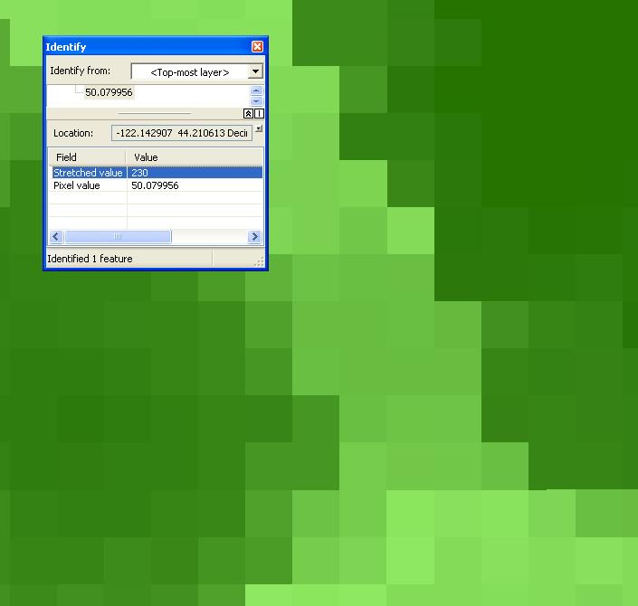
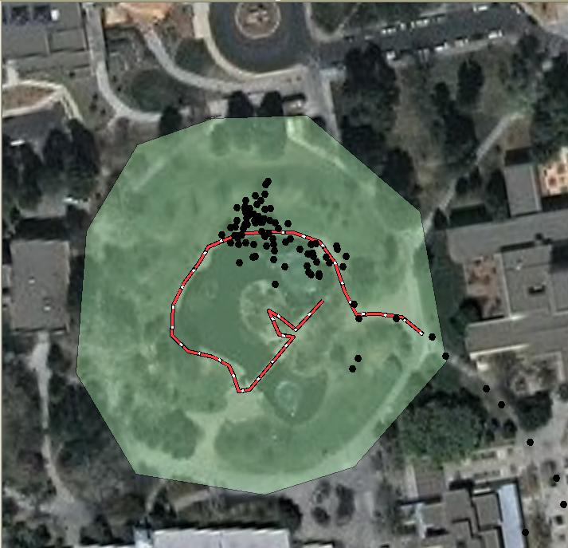
Spatial Data Geometry
row
Column
polygon
Pixel
Pixel value
line
point
Raster (grids, images)
Vector (lines, points,
polygons)

Slide 5
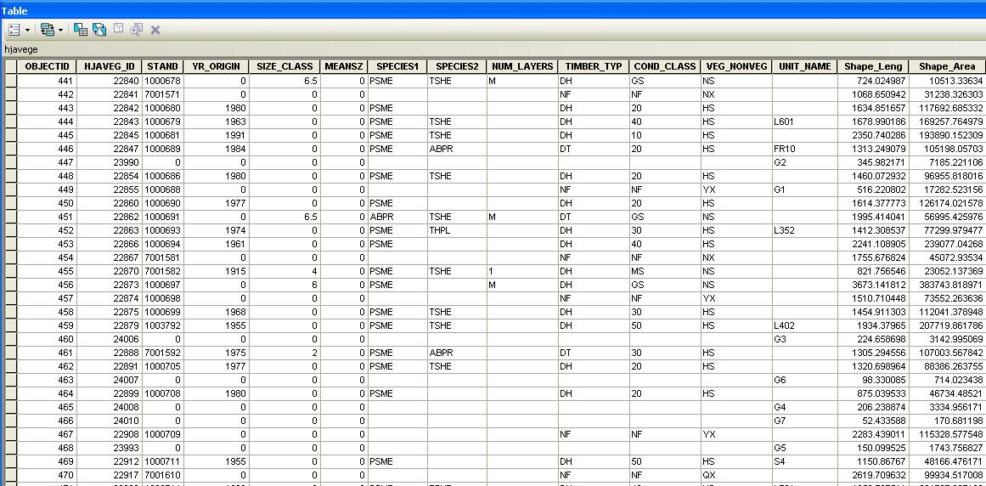
Associated Attribute Data
Describes characteristics of the spatial features
Stored in database file
Metadata describes each attribute (code = biomass, range of values, etc).

Slide 6
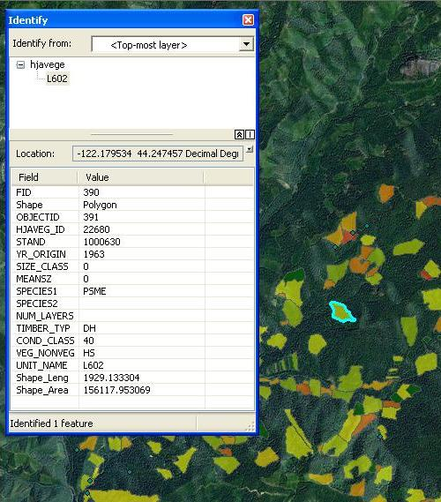
Attribute File is linked to the spatial data. You can select record in table and view on map, or feature on map and view in table.

Slide 7
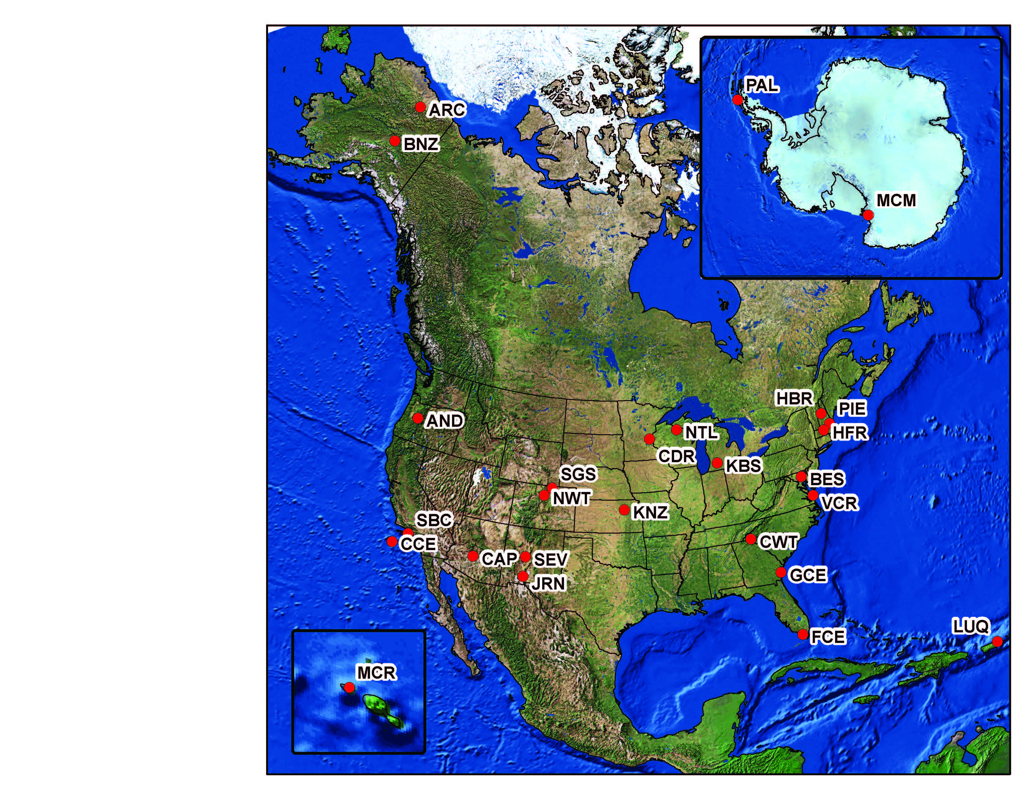
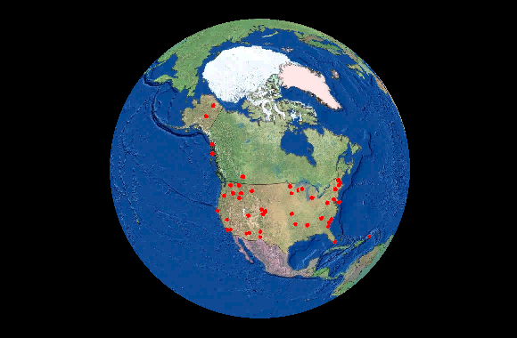
Projection: A map projection is any method of representing the surface of a sphere or other three-dimensional body on a plane. Map projections are necessary for creating maps. All map projections distort the surface in some fashion. (Wikipedia.org)
Shape, Area, Length

Slide 8
Spatial Data Formats
Raster:
Geo-tiffs
Esri grids (workstation or in geodatabases)
Imagine (.img)
Grass
DEM (digital elevation model)
Satellite data

Slide 9
Spatial Data Formats Cont.
Vector (topological) vs CAD based line work
ArcGIS (esri) formats:
Coverages
Shape files
File geodatabases
Personal geodatabases
SDE geodatabases
KML (Google) Keyhole Markup Language
AutoCad drawing files (DWG)
Digital Line Graphs (DLG)
Spatial Data Transfer System (SDTS)
Topologically Integrated Geographic Encoding and Referencing Files (TIGER): Census data
Point clouds: (from LiDAR data)

Slide 10
Exchange Formats/other extensions
KML: KMZ (compressed)
E00: ESRI coverage and grid exchange format
Zip: many times you find shape files zipped up
.mxd: file created when you make a map document in arcmap
.msd: file created from .mxd to optimize for a server
Layer files: saves symbology on a layer

Slide 11
ESRI GIS Software
ArcGIS is client side software: create and manage data, create maps, figures.
ArcServer is server side (used to develop map and image services)
ARCGIS API’s (used to develop web based applications with map and image services)

Slide 12
ArcGIS data types
Personal geodatabase: worked with Access, is being deprecated.
File geodatabase: similar to personal, but without the limitations of personal geodatabase, intended for use by one person at a time: (will get file locks between programs)
SDE Geodatabase: used with relational database such as Oracle, SQL Server. Intended for versioning and multiple users.
Older types: coverage and shape file: (file geodatabase to take place of shape file).

Slide 13
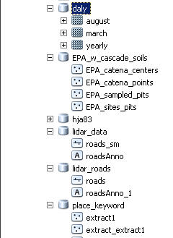
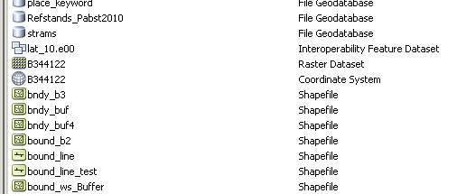
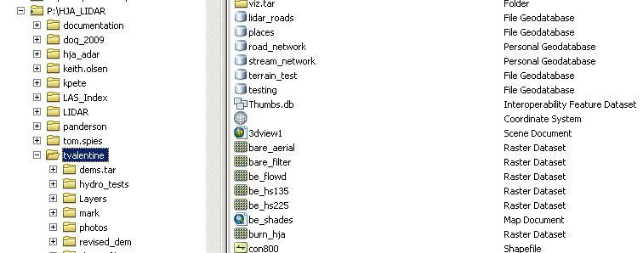

Slide 14
ArcGIS Desktop Modules
ArcGIS: 3 main modules:
ArcCatalog: manage files, metadata, preview, search
ArcMap: make maps, do analysis, editing
ArcToolbox: create models, manipulate your data, automate processes
Minor modules:
ArcGlobe: view data in 3D on a globe
Workstation (command line)
ArcScene: 3D data but not in global projection

Slide 15
Special consideration for archiving and publishing spatial datasets
Importing/exporting
Finding Existing Data to Meet your Research Goals
Connecting to external database tables
Map server technologies
Using ArcGIS on-line
Storage/access
File naming conventions
Publishing/archiving external source datasets
Study Site Locations

Slide 16
Import/Export
May need to import or export files (.e00)
Older structure used complicated file structure.
Don’t use windows explorer to copy/move data: use ArcCatalog.
Make sure that the projection is defined, and try and get your data into the same projection. (projection tools in arctoolbox under data management)

Slide 17
Finding Existing Data to Meet your Research Goals
Federal Agencies
State clearinghouses
Local governments/universities
LTER websites
NGO’s
Searches by topic on Google, Yahoo, etc
Evaluate quality, suitability of data. Is it recent, documented, have projection information, appropriate scale and extent?

Slide 18
Connecting to external database tables
MYSQL does not play nice with ArcGIS 10.0
Formatting of data columns can be difficult (ArcGIS often changes numeric to text)
Spatial join doesn’t work in some versions of ArcGIS 10
Software puts locks on files (shapefiles)

Slide 19
Map Services
Internet access to data, as you symbolized.
Users can download (option)
You can link to the server source in your EML
Mashup with other data sources (lots of services available on-line for free)
Good API tools to use within a website

Slide 20
ArcGIS On-line
Tools available to share data/applications.
Some limitations size/editing/access
Lots of on-line help and decent search.
Sometimes it’s better to search on Google.
http://www.arcgis.com/home/
You need to sign in, but it’s free.

Slide 21
Google Maps/Globe
Format is KML or KMZ
Type in location: Duck Pond, ABQ
Add your own data
Google Maps API: imbed map in your website
https://developers.google.com/maps/
LTERMapS: http://www.lternet.edu/map/index.php

Slide 22
Storage/Access
Organization on Network vs. what’s available on-line
ESRI has some searching tools (works if you use their metadata)
Raster data requires much more storage
LiDAR data (point clouds) are huge (Terabytes)
Image libraries can help
Find web services on-line, then you don’t have to copy data to your site.
Create a common directory for large datasets, where people can access, but not modify
Clean out your interim data. You will generate a lot of it and document your data as you create it.

Slide 23
File naming conventions
No blanks between words
Yes: boundary_hja.shp
No: boundary hja.shp
Keep your file names short (too long and they truncate). You can put long title in metadata
Keep your attribute titles short, as they tend to truncate as well, especially when you make several overlays or join data from another table

Slide 24
Publishing/archiving external source datasets?
Data is obtained from a GIS provider:
Clearinghouse, private company, etc.
When?
Extent of data has changed
Area of interest clipped from state-wide layer
Critical to research
Time sensitive (Census, land-ownership)
Include source metadata if available.

Slide 25
Study Site Locations
Lat/long in decimal degrees to the 6th decimal place
Single point locations
Lat/long create file, kml, or store in EML
File of point locations
Create event view in GIS, convert to a GIS file or KML
Make sure that you store data in numeric fields, not text fields
Don’t use MySQL if working with esri products.
Use highest quality of GPS unit to collect data
Correctable if possible and correct to closest base station
Best to record lat/long in NAD 83 or WGS 84 Datums

Slide 26
Documenting Spatial Data
Geo-spatial Metadata Formats
ESRI metadata editor
Automating Processes
Editing metadata help
Editing for EML
Exporting to FGDC Format
FGDC to EML Stylesheet
Process EML into a repository

Slide 27
Specific Help
Documenting GIS data power point
http://im.lternet.edu/node/968
Best Practices for documenting geospatial data version 2
http://im.lternet.edu/project/GIS_document
Esri2EML stylesheet
http://im.lternet.edu/project/Esri2Eml

Slide 28
Study Site Locations
Polygons, lines:
Store in GIS layer and add to EML as related file
Can convert simple polygons/lines in KML
Geographic Context:
Bounding boxes (min/max x and y)
For points, your min/max x and min/max y can be the same.
Capture information about your study site,

Slide 29
Creating GIS layer out of XY coordinate file:
File with lat/long or xy coordinates
Check format (needs to be numeric)
Create a shapefile or geodatabase
ArcMap:
Bring table/spreadsheet into ArcMap
Right click: display xy data (input geographic reference)
Export into shapefile or geodatabase
Data>export data (select shapefile or geodatabase)
ArcToolbox:
Data Management Tools>Layers and Table Views>make xy event layer

Slide 30
Creating a KML file
1. From Google: http://code.google.com/apis/kml/faq.html
2. Other tools:
http://batchgeo.com/ (puts your spreadsheet into Google maps)
shp2kml 2.0: Shape-file to Google Earth http://www.zonums.com/shp2kml.html
ArcToolbox: conversion tools>From KML and To KML

Slide 31
Demo
Google Search
Google Maps/Google Earth
ArcGIS (brief)
ArcMap (bringing in spreadsheet)
XML File section for geographic coverage

Slide 32
Exercise
Find coordinate data for all your study sites. You should have marked these areas on the exercise map when you were in the field.
From a web browser, go to Googlemaps.com
Search on “Duck Pond, ABQ”
Zoom into the Duck Pond,
Right click over your study site, and click: “what’s here”. Hover over/click the marker and you will see the coordinates: (negative number is the longitude, positive is the latitude) copy and paste into your spreadsheet/document.
Longitude will be the Easting/Westing Coordinates, and Latitude will be the Northing/Southing
Create map of study area using Google Maps or ArcGIS*.
Create map after logging into google.
My places: Create Map (interactive tutorial)
Right click: “Add a place marker” (title, description)
Right click on spot, “what’s here” to get lat/long. (hover over marker)
Draw a line/shape
Save/print: (not sure how to get image instead of base map)
* Create GIS data out of xy coordinates: add spreadsheet to arcmap, and create a point layer out of the points
Extra Credit:
Export data to KML/Google
Add Lat/Lon data to EML file:
Add at Dataset Level (largest extent of all your points)
Add in methods: for points, you have the same value for n/s and e/w

Slide 33
Geographic Coverage at the Dataset Level for EML
geographicCoverage
General Information: The <geographicCoverage> element is used to describe geographic locations of research sites and areas related to the dataset. It is recommended to use the element at different levels for different types of information. Clearly there are many ways this element can be used and this document recommends one approach to make EML within LTER more consistent and easier to use in applications like the LTERMapS.
At the dataset level (eml:eml/dataset/coverage) one <geographicCoverage> element should be included, whose <boundingCoordinates> describe the extent of the data. As a default, the bounding box could describe the entire LTER site as stored in SiteDB. However, it is strongly recommended that a more accurate extent of observations be provided, i.e., the maximum extent of the data, for each of east, west, north and south. Additional <geographicCoverage> elements may be entered at the dataset level if there are significant distances between study sites and it would be confusing if they were grouped into one bounding box. For example, cross-site studies where a bounding box would represent North American or more should have two bounding boxes, one for each site.
Example: geographicCoverage at the dataset level
<coverage>
<geographicCoverage>
<geographicDescription>Ficity, FI metropolitan area, USA</geographicDescription>
<boundingCoordinates>
<westBoundingCoordinate>-112.373614</westBoundingCoordinate>
<eastBoundingCoordinate>-111.612936</eastBoundingCoordinate>
<northBoundingCoordinate>33.708829</northBoundingCoordinate>
<southBoundingCoordinate>33.298975</southBoundingCoordinate>
<boundingAltitudes>
<altitudeMinimum>300</altitudeMinimum>
<altitudeMaximum>600</altitudeMaximum>
<altitudeUnits>meter</altitudeUnits>
</boundingAltitudes>
</boundingCoordinates>
</geographicCoverage>
</coverage>

Slide 34
From EML Best Practices: Spatial Sample Units in Methods
If sampling took place in discrete point locations, those sites should appear at eml:eml/dataset/methods/sampling/spatialSamplingUnits/coverage. A list of individual sampling sites should be entered under <spatialSamplingUnits>, each site in a separate coverage element. More information about sampling sites can be found under <methods>,
Example: geographicCoverage for single sampling point locations
<spatialSamplingUnits>
<coverage>
<geographicDescription>sitenumber 1</geographicDescription>
<boundingCoordinates>
<westBoundingCoordinate>-112.2</westBoundingCoordinate>
<eastBoundingCoordinate>-112.2</eastBoundingCoordinate>
<northBoundingCoordinate>33.5</northBoundingCoordinate>
<southBoundingCoordinate>33.5</southBoundingCoordinate>
</boundingCoordinates>
</coverage>
<coverage>
<geographicDescription>sitenumber 2</geographicDescription>
<boundingCoordinates>
<westBoundingCoordinate>-111.7</westBoundingCoordinate>
<eastBoundingCoordinate>-111.7</eastBoundingCoordinate>
<northBoundingCoordinate>33.6</northBoundingCoordinate>
<southBoundingCoordinate>33.6</southBoundingCoordinate>
</boundingCoordinates>
</coverage>
<coverage>
<geographicDescription>sitenumber 3</geographicDescription>
<boundingCoordinates>
<westBoundingCoordinate>-112.1</westBoundingCoordinate>
<eastBoundingCoordinate>-112.1</eastBoundingCoordinate>
<northBoundingCoordinate>33.7</northBoundingCoordinate>
<southBoundingCoordinate>33.7</southBoundingCoordinate>
</boundingCoordinates>
</coverage>
</spatialSamplingUnits>
Latitudes and longitudes should be in the same commonly used datum (i.e., all values in WGS84 or NAD83) and expressed to at least six decimal places (the EML2.1 schema enforces decimal content). International convention dictates that longitudes east of the prime meridian and latitudes north of the equator be prefixed with a plus sign (+), or by the absence of a minus sign (-), and that west longitudes and south latitudes be prefixed with minus sign (-). See Example above. See the EML specification for more information and other examples.
<geographicDescription> The description is a string. It should be comprehensive and include the country, state, county or province, city, general topography, landmarks, rivers, and other relevant information. The method for determining <boundingCoordinates>,

